Slide 1
Practical Computation Theory
Chuck Allison
Utah Valley State College

Slide 2
The UVSC CS Student
Average age in mid-to-high-20s
Most are married
Many, if not most, are employed in a CS-related area
Few go on to graduate school
  Those that do, do very well, thank you!
None are mathematicians :-)
  Formal proofs shut their brains down

Slide 3
An Observation
“Undergraduate Computer Science majors generally do not speak the language of mathematical symbolism fluently, nor is it important at their level that they do more than try… It is at best a means to an end. To those to whom it is opaque, it is a hindrance to understanding. When this happens it is mathematically dysfunctional and a pedagogical anathema.”
-- Cohen

Slide 4
Practical Computation Theory
Avoiding a “hindrance to understanding”
Establish results with the least amount of mathematical formalism possible
  But no less :-)
Proofs can be informal, constructive, and intuitive
  No less true than formal methods!
Motivate with applications, hands-on work
  Programming assignments

Slide 5
Notice
I’m very interested in sharing approaches and techniques for teaching comp. theory
Feel free to join mail list at theory@uvsc.freshsources.com
  Mail once to theory-subscribe@uvsc.freshsources.com
    Respond to confirmation mail
  Or just email me at allisoch@uvsc.edu
    I’ll manually add you

Slide 6
Pedagogical Aids
Many are in the literature
  But never in one text book!
  Constructive, visual ways to establish theory
Rabin-Scott technique for converting and combining FAs
“Algebraic” removal of null rules in a CFG
Visual “tableau” approach to CYK Algorithm
The Halting Dog Problem

Slide 7
Rabin-Scott Technique
For converting NFAs to DFAs
Also useful for computing union, Kleene*, intersection, and concatenation of DFAs
Technique:
  Determine start state
    May be composite
  See where it takes you!

Slide 8
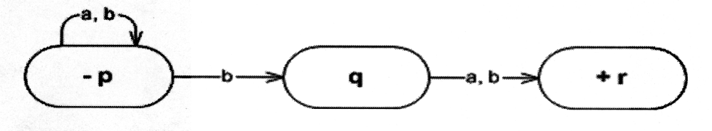
Example
Next-to-last letter is a ‘b’
 | a | b
-p

Slide 9
Example
Next-to-last letter is a ‘b’
 | a | b
-p | p | pq
pq | pr | pqr
+pr | p | pq
+pqr | Pr | pqr
 | a | b
-p

Slide 10
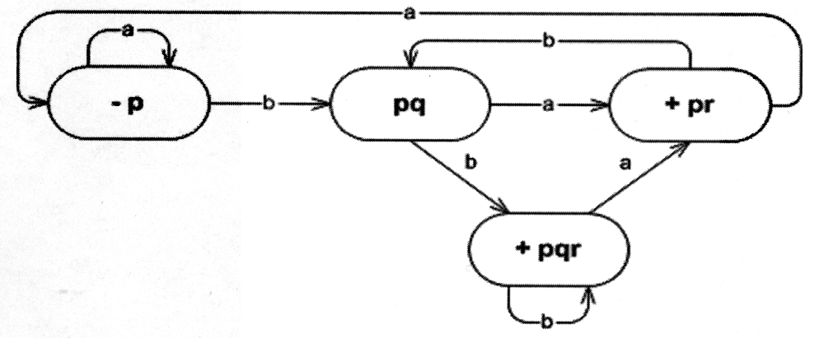
Example
Next-to-last letter is a ‘b’

Slide 11
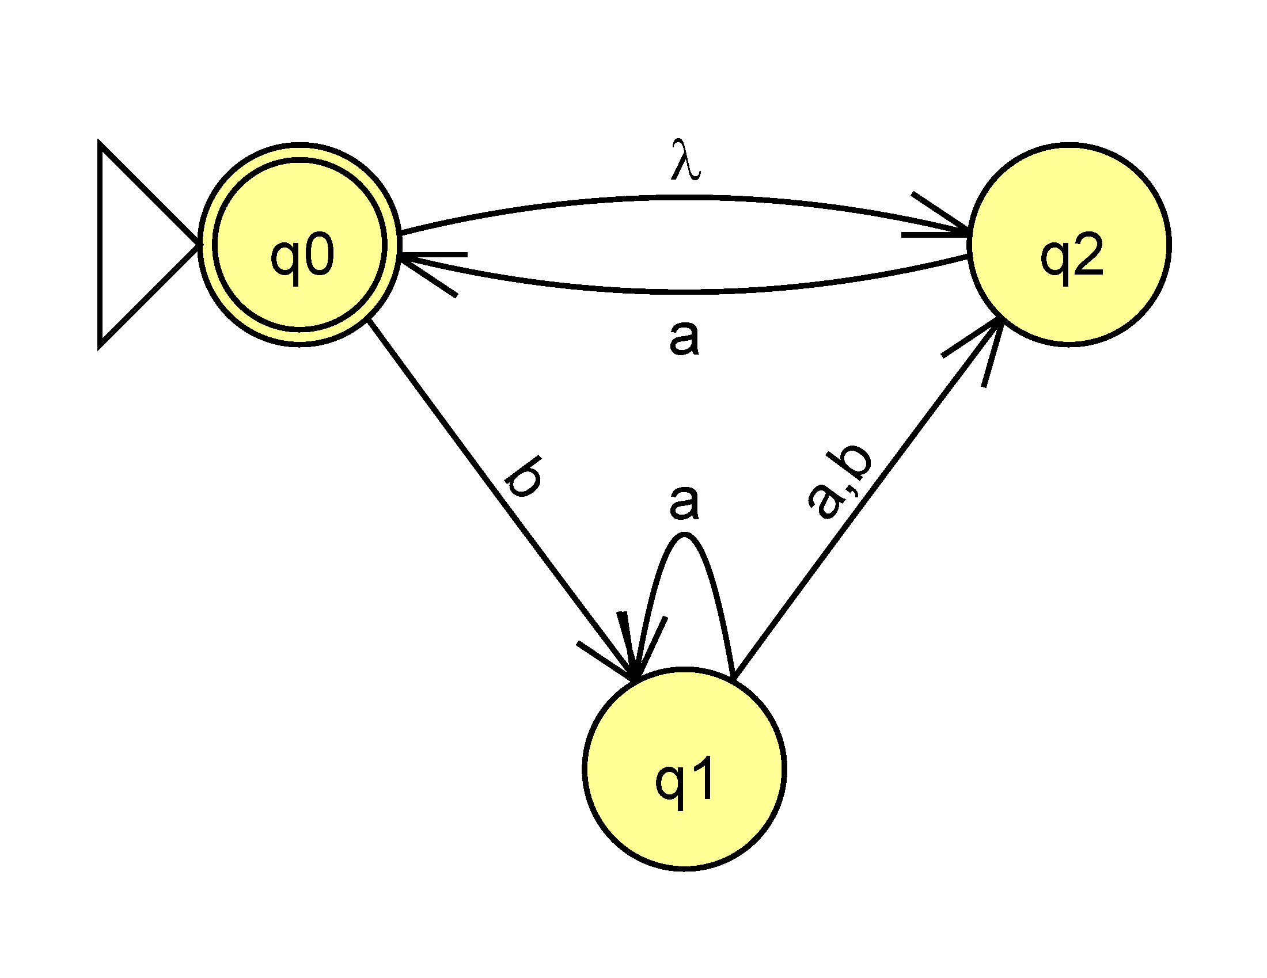
Example with λ-transitions
 | a | b
{q₀, q₂} | {q₀, q₂} | q₁
q₁ | {q₁, q₂} | q₂
{q₁, q₂} | {q₀, q₁, q₂} | q₂
q₂ | {q₀, q₂} | φ
{q₀, q₁, q₂} | {q₀, q₁, q₂} | {q₁, q₂}

Slide 12
Union and Intersection of FAs
FA₁
FA₂
a b
-x₁ x₂ x₁
x₂ x₃ x₁
+x₃ x₃ x₃
a b
+/-y₁ y₃ y₂
y₂ y₄ y₁
y₃ y₁ y₄
y₄ y₂ y₃

Slide 13
x_{i,} y_{i} | a | b
x_{1,} y₁ | x₂, y₃ | x₁, y₂
x_{2,} y₃ | x₃, y₁ | x₁, y₄
x_{1,} y₂ | x₂, y₄ | x₁, y₁
x_{3,} y₁ | x₃, y₃ | x₃, y₂
x_{1,} y₄ | x₂, y₂ | x₁, y₃
x_{2,} y₄ | x₃, y₂ | x₁, y₃
x_{3,} y₃ | x₃, y₁ | x₃, y₄
x_{3,} y₂ | x₃, y₄ | x₃, y₁
x_{2,} y₂ | x₃, y₄ | x₁, y₁
x_{1,} y₃ | x₂, y₁ | x₁, y₄
x_{3,} y₄ | x₃, y₂ | x₃, y₃
x_{2,} y₁ | x₃, y₃ | x₁, y₂
For union: assign accepting states where any original x_{i} or y_{i} accept.
For intersection: assign accepting states only where both original x_{i} and y_{i} accept simultaneously.

Slide 14
Computing Concatenation and Kleene Closure
Concatenation:
  Draw lambda transitions from ends of FA₁ to start of FA₂
  Convert this NFA to a DFA
Kleene Closure:
  Construct an accepting start state if needed
    Replicating out-edges from original start state
  Draw lambdas from end states to start state
  Convert this NFA to a DFA

Slide 15
Removing Null Grammar Rules
Simple, foolproof technique:
Replace each nullable, A, with (A+λ)
“Multiply” through
Drop null rules…

Slide 16
Removing Null Grammar Rules
Example
S → ASA | aB
A → B | S
B → b | λ
S → (A+λ)S(A+λ) | a(B+λ) → ASA | AS | SA | S | aB | a
A → (B+λ) | S → B | S
B → b

Slide 17
CYK Algorithm
For determining if s ε L(G)
A Dynamic Programming algorithm
  Based on CNF (Chomsky Normal Form)
Start with rules of the for X → a
“Backtrack” to reach S
Can be done compactly with a single triangular matrix

Slide 18
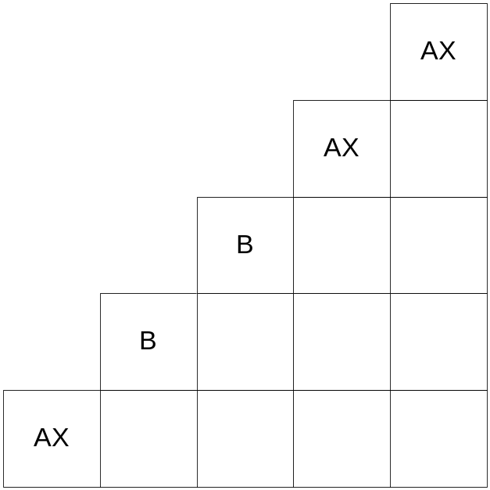
CYK Algorithm
Example
S → XY
X → SY
Y → SS
X → a | BB
Y → AA
A → a
B → b
String: abbaa

Slide 19
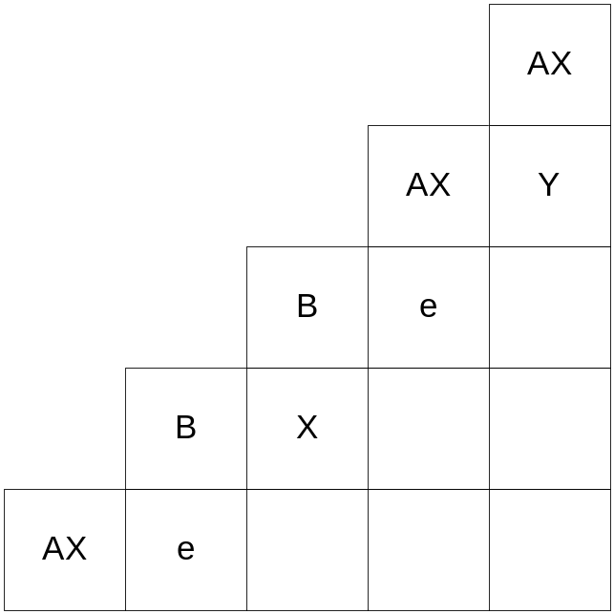
CYK Algorithm
Example
S → XY
X → SY
Y → SS
X → a | BB
Y → AA
A → a
B → b

Slide 20
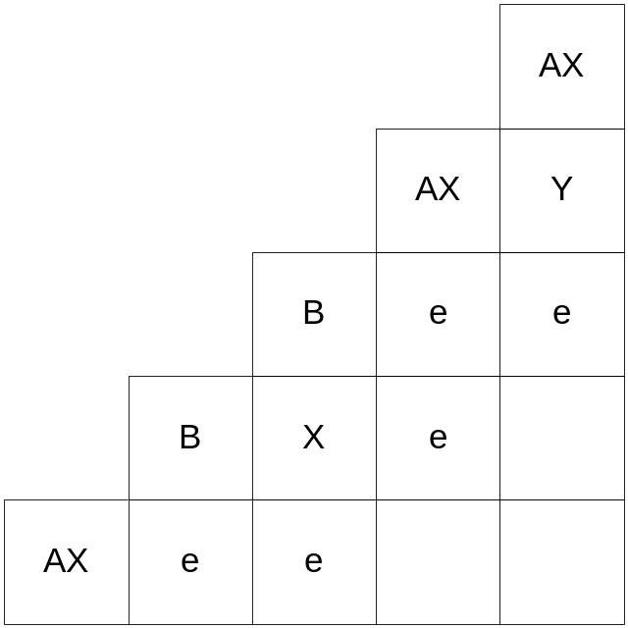
CYK Algorithm
Example
S → XY
X → SY
Y → SS
X → a | BB
Y → AA
A → a
B → b

Slide 21
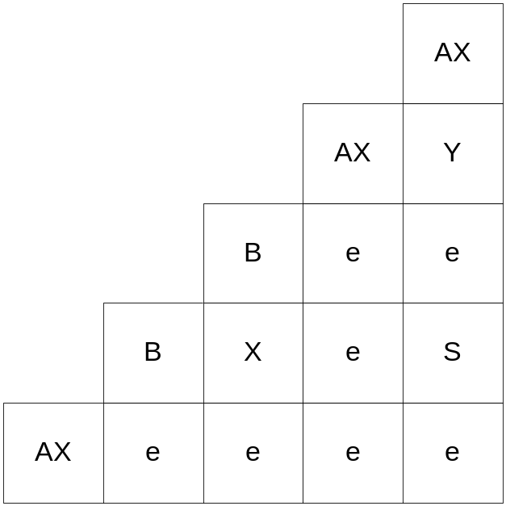
CYK Algorithm
Example
S → XY
X → SY
Y → SS
X → a | BB
Y → AA
A → a
B → b

Slide 22
PDA to CFG Conversion
Lewis & Papdimitriou technique
  Spread out multi-pops
  http://uvsc.freshsources.com/Courses/CNS_3240/Slides/PDA2CFG.doc
I’ve had students write Excel macros and Python programs for it!
  To check their work

Slide 23
The Halting Dog Problem
//www.everything2.com/index.pl?node_id=1147557
Meg, the psychic dog, only barks at dogs that won’t bark at themselves in the mirror.
What happens when Meg looks in the mirror?
An exact analogue of the proof!

Slide 24
Programming Assignments
Basic DFA implementation
  Case statement vs. transition table in 2-d array
/*…*/ Comment removal
  Mealy machine (modified)
Shuntyard algorithm
  prefix/postfix notation
Random sentence generation
  Simulating a grammar

Slide 25
Questions?

